Slide 1
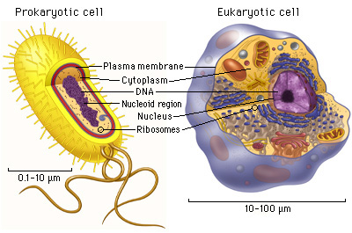
Prokaryotic and eukaryotic cell structure
Aidas Bertulis
2013, Šiauliai
Jurgita Šerniūtė
2013, Kaunas

Slide 2
THE MAIN AIM: to learn about prokaryotic and eukaryotic cell structure.
OBJECTIVES:
To learn the features of prokaryotic cell.
To learn the features of eukaryotic (animal) cell.
To learn to describe the differences and similarities of the two types.
To accomplish topic-related tasks.

Slide 3
Complete Task 1 :
Indicate the cell type.
Watch the video and fill in the table by matching the cell characteristics to the particular cell.

Slide 4
Answers
Bacteria and cyanobacteria - prokaryote.
All other cells - eukaryote.
No nucleus - prokaryote.
True nucleus - eukaryote.
Lack membrane bound organelles - prokaryote.
Possess subcellular organelles - eukaryote.
Evolve from much smaller prokaryotic cells - eukaryote.
Contain DNR - prokaryote and eukaryote.
DNR is visible as a long irregularly shaped molecule - prokaryote.
DNR is packaged together with special proteins called chromosomes - eukaryote.
Specific number of chromosomes - eukaryote.
Cell membrane, cytoplasm and various organelles - prokaryote and eukaryote.
Have ribosome and make proteins - prokaryote and eukaryote.

Slide 5
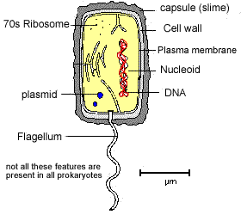
Prokaryotic cell structure
The general size of a prokaryotic cell is about 1-2 um;
Membrane bound organelles are absent;
There is no true nucleus with a nuclear membrane;
The ribosome's are smaller than those of eukaryotic cells;
The slime capsule is used as a means of attachment to a surface.
Only flagellate bacteria have the flagellum;
Plasmids are very small circular pieces of DNA that may be transferred from one bacteria to another.

Slide 6
Cell Wall:
Made of a murein (not cellulose), which is a glycoprotein or peptidoglycan (i.e. a protein/carbohydrate complex).
Plasma membrane:
Controls the entry and exit of substances, pumping some of them in by active transport.
Cytoplasm:
Contains all the enzymes needed for all metabolic reactions, since there are no organelles.
Ribosome:
The smaller (70 S) type are all free in the cytoplasm, not attached to membranes (like RER). They are used in protein synthesis which is part of gene expression.
Nucleoid:
Is the region of the cytoplasm that contains DNA. It is not surrounded by a nuclear membrane. DNA is always a closed loop (i.e. a circular), and not associated with any proteins to form chromatin.
Flagella:
These long thread like attachments are generally considered to be for movement.

Slide 7
Pili:
These thread like projections are usually more numerous than the flagella. They are associated with different types of attachment. In some cases they are involved in the transfer of DNA in a process called conjugation or alternatively as a means of preventing phagocytosis.
Slime Capsule:
A thick polysaccharide layer outside of the cell wall, like the glycocalyx of eukaryotes. Used for sticking cells together, as a food reserve, as protection against desiccation and chemicals, and as protection against phagocytosis. In some species the capsules of many cells in a colony fuse together forming a mass of sticky cells called a biofilm. Dental plaque is an example of a biofilm.
Plasmids:
Extra-nucleoid DNA of up to 400 kilobase pairs. Plasmids can self-replicate particularly before binary fission.
They are associated with conjunction which is horizontal gene transfer.
It is normal to find at least one anti-biotic resistance gene within a plasmid.

Slide 8
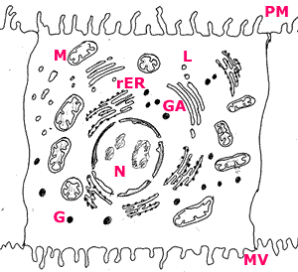
Eucaryotic (animal) cell structure
N:Nucleus
PM: plasma membrane
M: mitochondria
rER: Rough endoplasmic reticulum
GA: Golgi apparatus
L: Lysosome
MV: Microvilli

Slide 9
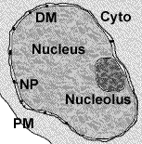
Nucleus: This is the largest of the organelles. The nucleus contains the chromosomes which during interphase are to be found in the nucleolus.
The nucleus has a double membrane with pores(NP).
The nucleus controls the cell’s functions through the expression of genes.
Some cells are multi nucleated such as the muscle fibre.

Slide 10
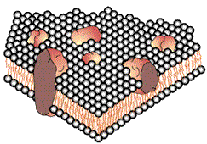
Plasma membrane: controls which substances can enter and exit a cell. It is a fluid structure that can radically change shape.
The membrane is a double layer of water repellant molecules.
Receptors in the outer surface detect signals to the cell and relay these to the interior.
The membrane has pores that run through the water repellant layer called channel proteins.

Slide 11
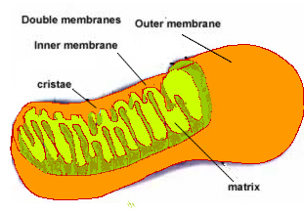
Mitochondria: location of aerobic respiration and a majot synthesis of ATP region.
Double membrane organelle.
Inner membrane has folds called cristae. This is the site of oxidative phosphorylation.
Centre of the structure is called the matrix and is the location of the Krebs cycle.
Oxygen is consumed in the synthesis of ATP on the inner membrane
The more active a cell the greater the number of mitochondria.

Slide 12
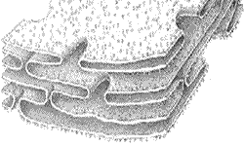
Rough endoplasmic reticulum (rER): protein synthesis and packaging into vesicles.
rER form a network of tubules with a maze like structure.
In general these run away from the nucleus
The 'rough' on the reticulum is caused by the presence of ribosomes.
Proteins made here are secreted out of the cell

Slide 13
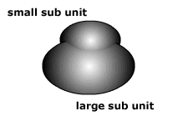
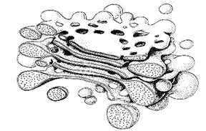
Ribosomes: the free ribosome produces proteins for internal use within the cell.
Golgi apparatus: modification of proteins prior to secretion.
proteins for secretion are modified
possible addition of carbohydrate or lipid components to protein
packaged into vesicles for secretion

Slide 14
Lysozyme:
Vesicles in the above diagram that have formed on the golgi apparatus.
Containing hydrolytic enzymes.
Functions include the digestion of old organelles, engulfed bacteria and viruses.

Slide 15
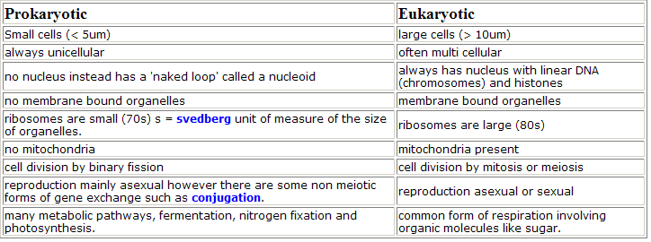
Comparison of prokaryotic and eukaryotic cells

Slide 16
Complete: Task 2
Ascribe the cell characteristics to either plants or animals cell

Slide 17
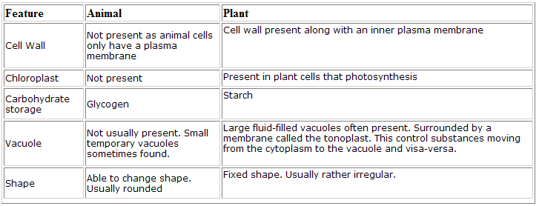
Answers

Slide 18
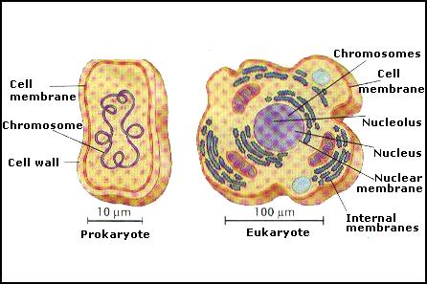
References
Click4biology. Internetinė prieiga: http://click4biology.info/c4b/2/cell2.3.htm

Slide 19
Homeworks
Watch video retrieved from http://www.youtube.com/watch?v=1Z9pqST72is. NOTE – start waching from 3:51!
Write the titles of cell parts. Take 4 new facts that you didn't hear today and present it next class.

Slide 20
Answer:
1
2
3
4
5
6
7
8
9
10
11
12
13
4
5
Cell structure

